Slide 1
NATIONAL CULTURE
Dr. Kwangsoo Kim
Konkuk University

Slide 2
DEFINITION
Culture is a system of values and norms that are shared among a group of people and that, when taken together, constitute a design for living
- Values: abstract ideas about what a group believes to be good, right, and desirable.
- Norms: the social rules and guidelines that prescribe appropriate behavior in particular situations.
Culture is a shared system of meaning, ideas, and thought. It guides our perception and understanding of the world, and it shapes our behavior.
Different levels of culture can coexist.
Notes:
d

Slide 3
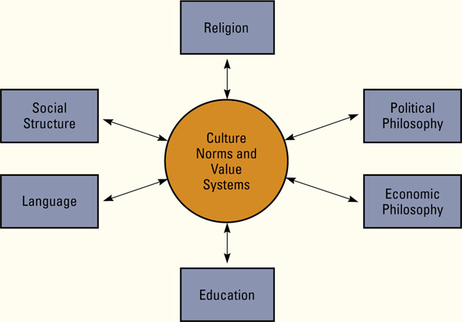
DETERMINANTS

Slide 4
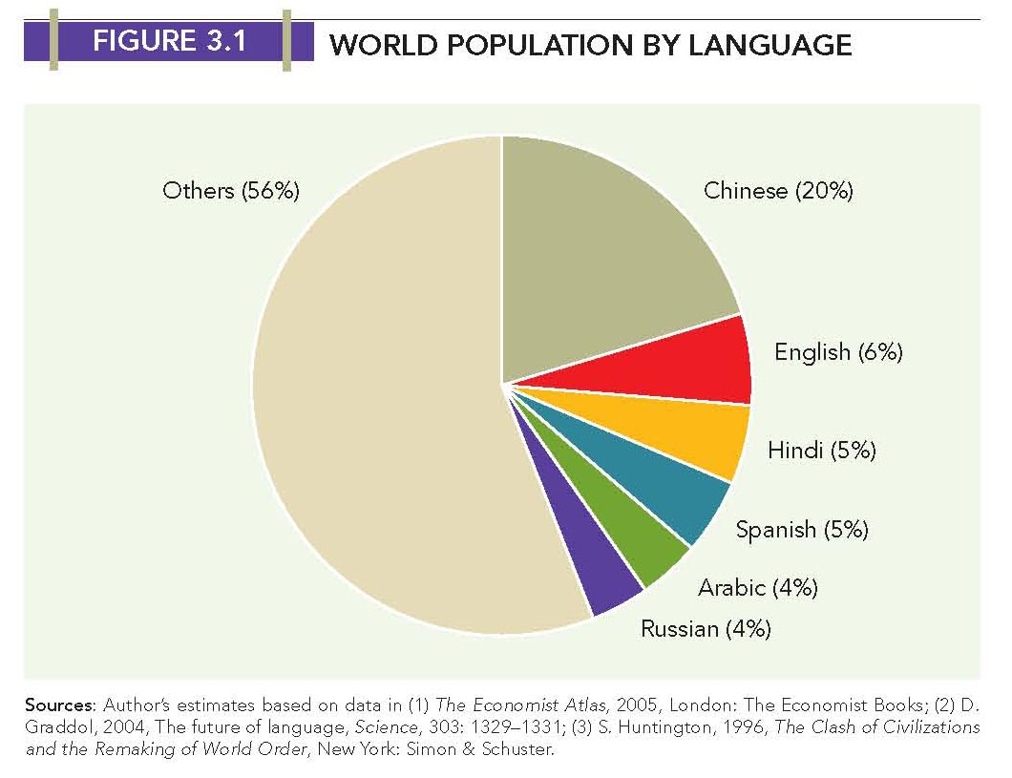
World Population by Language

Slide 5
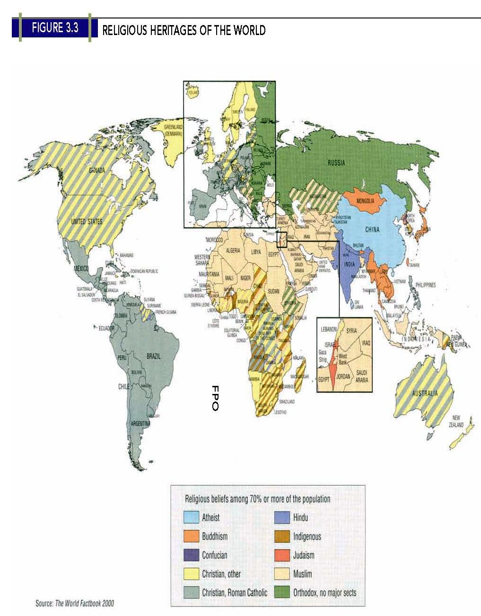
Religious Heritages of the World

Slide 6
DIMENSIONS: Edward Hall
Culture is a means of communication which takes place through symbols or “silent languages” (Edward Hall in the late 1950s)
- the language of time: The way people approach to time
- the language of space: The way people use space
- the language of material goods: The way people view these
- the language of friendship: The way people make friends
- the language of agreement: The way people express agreement

Slide 7
Business and Interpersonal Relationships in Low/High Context Cultures
Context | Low | Medium | High
Country/regional examples | N. American, Scandinavian, Swiss, German | Greek, Spanish, Italian, French, Dutch, British | Asian, Arabic, Latin American
Meeting people | Informal | Formal | Formal
Getting acquainted | Fast | Moderate | Slow
Relationship depth | Shallow | Moderate | Deep
Relationship trust | Little | Trust | Much trust
Behavior limits | Legal | Legal/social | Social
Lawyer reliance | High | Moderate | Low

Slide 8
Business and Interpersonal Relationships in Low/High Context Cultures
Context | Low | Medium | High
Business relationships | Arm’s length | Social-business mixed | Much socializing
Insider-outsider | Low | Moderate | High
Social class differences | Low/moderate | Moderate | High
Patriarchal | Low | Moderate | High
Individualism | High | Moderate | Low
Individual competition | Encouraged | Discouraged | Anti-social
Uncertainty tolerance | High | High | Low
Mistakes tolerance | High | Medium | Low
Mistakes accountability | High | Medium | Low

Slide 9
DIMENSIONS: Geert Hofstede
Power Distance
- Degree of hierarchical social inequality considered normal
by people
- Distance between individuals at different levels of a societal
hierarchy
Individualism Vs. Collectivism
- Degree to which people in a country prefer to act as
individuals rather than in groups
- Describes the relations between the individual and his/her
fellows
Uncertainty Avoidance
- Degree of need to avoid uncertainty about the future
- Degree of preference for structured versus unstructured
situations

Slide 10
DIMENSIONS: Geert Hofstede
Masculinity vs. Femininity
- Division of roles and values in a society
- Masculine values prevail:
assertiveness, success, competition
- Feminine values prevail:
quality of life, maintenance of warm personal relationships, service, care for the weak, solidarity
Long-term Orientation (Confucian Dynamism)
- Attitudes towards:
Long time frames & persistence
Reciprocity --gifts and favors
Respect for status & tradition
Concerns for “Face”

Slide 11
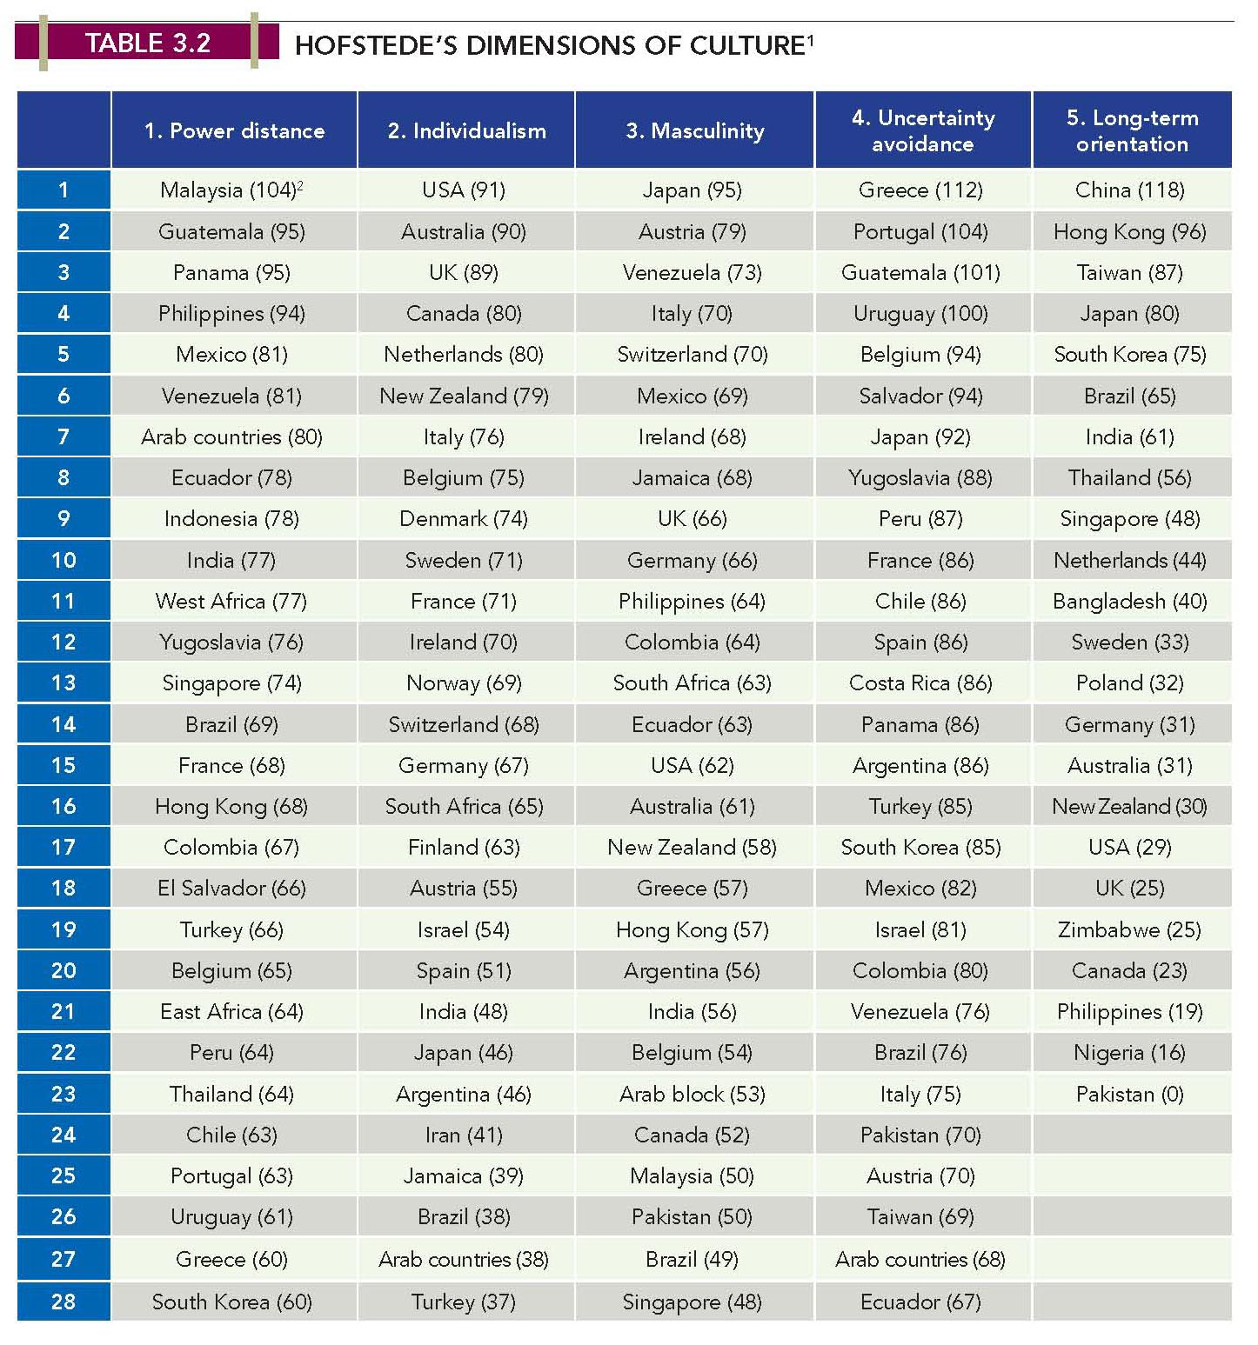
Hofstede’s Cultural Dimensions

Slide 12
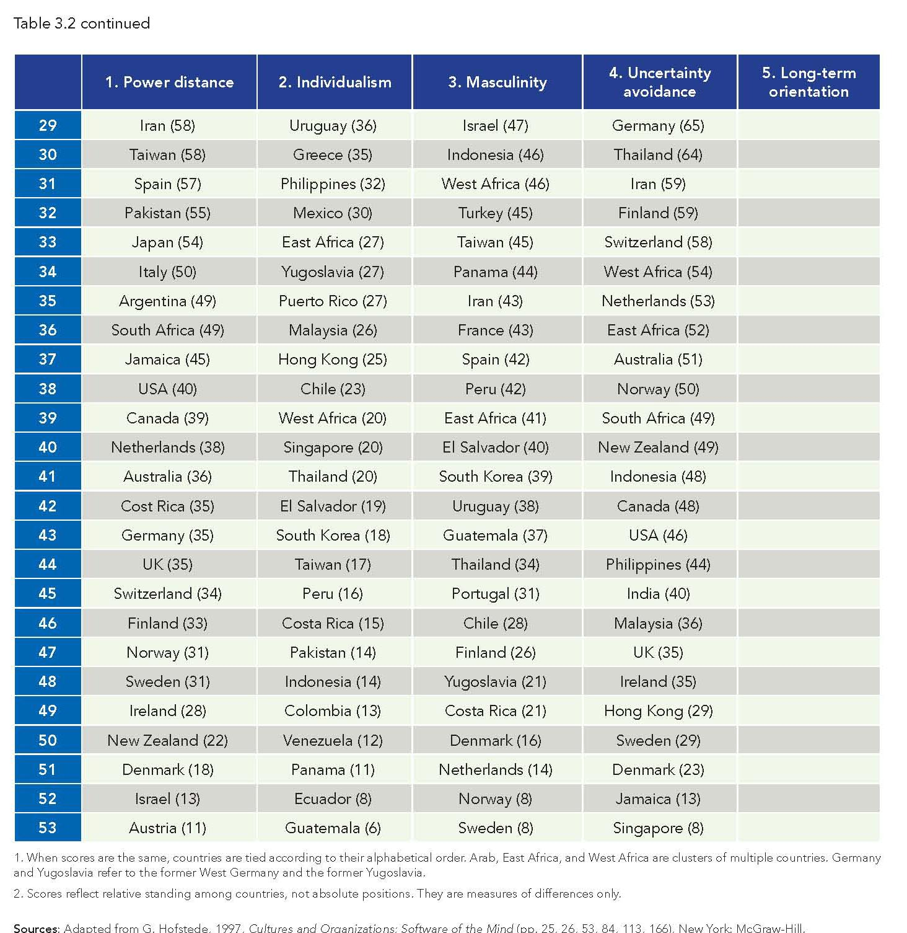
Hofstede’s Cultural Dimensions

Slide 13
CULTURE & BUSINESS PRACTICES (Lessons for Managers)
Interactions Between Firms
Negotiations with suppliers/customers and collaborative activities
At the early stage of interaction, in many countries, the specifics of business negotiation can only be discussed after a basis of trust/mutual respect has been developed
Once involved in active negotiation, paying attention to the “silent languages” of time and agreement becomes important.
The specificity with which a contract is drawn up may also be important. Managers from a low-context culture tend to seek precise terms and clauses to cover all aspects of the agreement explicitly, while managers from a high-context culture tend to prefer a shorter agreement with less emphasis on the explicit terms and more weight on trust and mutual obligation.

Slide 14
CULTURE & BUSINESS PRACTICES (Lessons for Managers)
Interactions Within Firms
Organizations with members from different cultures likely face the following challenges.
How to deal with members’ different levels of power distance with respect to power relations among members
How to deal with members’ individualistic or collectivistic inclination with respect to participation and decision making
How to deal with members’ individualistic or collectivistic inclination with respect to motivation, performance evaluation, and reward/compensation

Slide 15
IMPLICATIONS FOR BUSINESSES
There is a need for managers to develop cross-cultural literacy
- Understanding national culture and its role in management is important for international businesses (negotiation & management)
- Not just understanding the differences of national cultures in some undefined way but understanding distinctive behavior various cultural group may exhibit
- Managers should develop an awareness of their own cultural behavior – their own implicit assumptions about time, expression of agreement, individualism, & power distance
The relative importance of culture varies depending on situations.
- More important for social settings like negotiations than for technical systems like financial models, process control systems, manufacturing systems

Slide 16
IMPLICATIONS FOR BUSINESSES
There is a connection between culture and national competitive advantage
- The values and norms of a society influence the cost of doing business, which in turn affect the ability of firms to establish a competitive advantage.
- Hinduism or Islam may not be as supportive of capitalism as Protestantism and Confucianism. (Islamic laws banning interest payments)
- The connection has implications for the choice of countries in
which to locate production facilities and do business
Differences in national culture are still very high, but national cultures tend to change over time. National cultures seem to be converging rather than diverging especially in young generations

